Slide 1
CPE 404
Computer Hardware Design
Dr Osama Hosameldeen
Spring 2021
Lecture 10
Multiplexer and Bus based Register Transfers

Slide 2
Topics
Data Paths and Operations
  The Arithmetic/Logic Unit
Register Transfer Operations
  Micro-Operations
Multiplexer-Based Transfer
Bus-Based Transfer
Complete Data Path Design
Pipelining
Notes:
School of Engineering

Slide 3
Multiplexor Based Transfer

Slide 4
Multiplexer-Based Transfers
There are occasions when a register receives data from two or more different sources at different times.
Recall that multiplexers are used to conditionally transfer values from the input to the output.
Therefore, multiplexers can be used to create such based transfers.

Slide 5
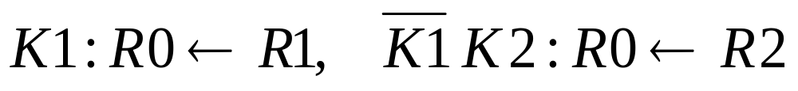
Multiplexer-Based Transfers
Consider
Which can also be expressed in RTL as:
Notice the data transfer to R₀ is dependent on either:
  K1 in the case R₀ ← R₁
  K2 in the case R₀ ← R₂
Block diagram?

Slide 6
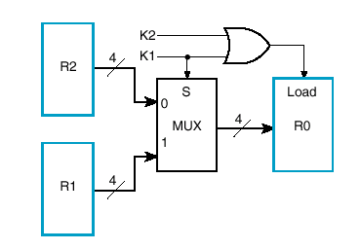
Multiplexer Block Diagram
K₁ is a control signal that selects the source (R₂ or R₁)
Either K₁ or K₂ will load the value into R₀)

Slide 7
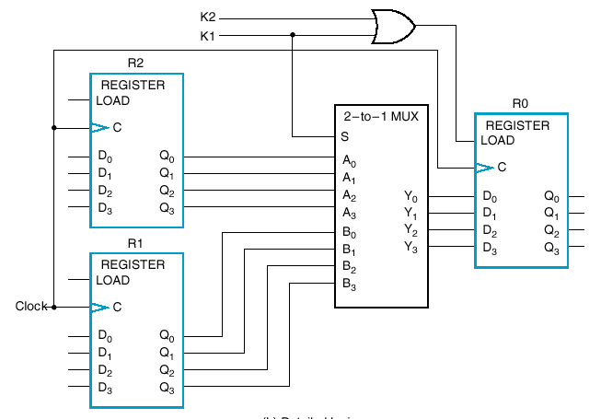
Detailed

Slide 8
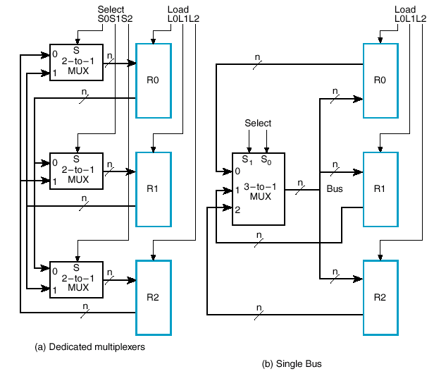
Simple Case: Using Muxes!
Signals from the Control Unit
Signals S₂, S₁, S₀ select the source
R1→R0, R2→R0
Signals L₀, L₁, L₂ enable loading of the registers.
The single bus (on the right)
  One mux
  One output bus
Advantages?
Capabilities??
Limitations??
Destination
Source
Source
R1 → R0, R2 → R0
R1 → R0, R0 → R1
Swap of Registers

Slide 9
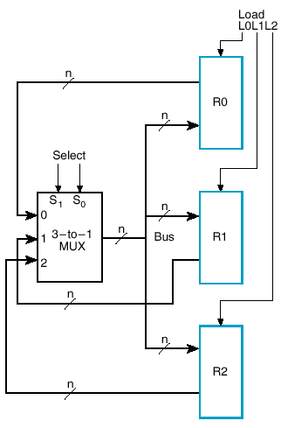
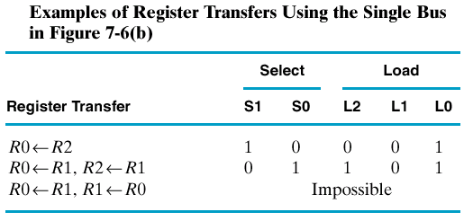
Transfers
About ½ the hardware
Select/Load Signals (table)
Limitations!
  Swapping is not possible!!

Slide 10
Bus Based Transfer

Slide 11
Bus-Based Transfers
How about when there are lots of registers?
We can use buses and send data over common set of wires
  Busses are more efficient scheme for transferring data between registers!

Slide 12
Bus-Based Transfers
A Bus is a shared transfer path.
  It is characterized by a set of common lines (i) Data + (ii) Control, (iii) Status
The control signals for the logic select a single source and one or more destinations on any clock cycle.
SRC1
DEST1
Data
Control
DEST2
Status
SRC2

Slide 13
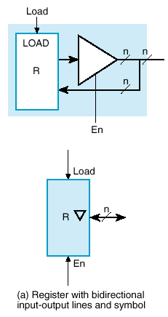
Three-State Bus
Remember three-state drivers allow having multiple outputs share wire
  Note the small inverted triangle denotes the 3-state output of the register.
A bus can be constructed with the tri- state buffers.
Many three state buffer outputs can be connected together to form a bit line of a bus
  less delay than multiplexer based systems

Slide 14
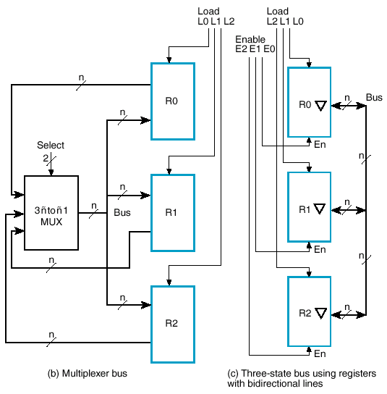
Same Example with 3-State
Notice that both systems in the figure have the same capability in term of transfers.
However the 3-state bus has:
  Fewer wires
  Fewer components
  Easier to expand!

Slide 15
Memory Transfer

Slide 16
Memory Transfers
Usually one or more buses associated with memory
  Address
  Data
Note that memory can be slower, so may have to use complex timing
  Address on one clock cycle
  Data latched at later clock cycle

Slide 17
Properties of Memory
Volatile
  Memory content disappears if power goes out
    Typical computer RAM
    Static RAM (SRAM), → Cache
    Dynamic RAM (DRAM) → Main Memory
Nonvolatile
  ROM
  Flash memories
  Magnetic memories like disk, tape

Slide 18
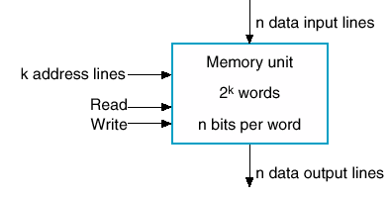
Simple View of RAM
Word size n-bits
Some capacity 2^{k}
k bits of address line
A read line
A write line

Slide 19
Memory Transfer
Read: DR ← M[AR] where
  M denotes Memory,
  DR denotes Data Register, and
  AR denotes Address Register
Write: M[AR] ← DR
Write: M[A1] ← D2

Slide 20
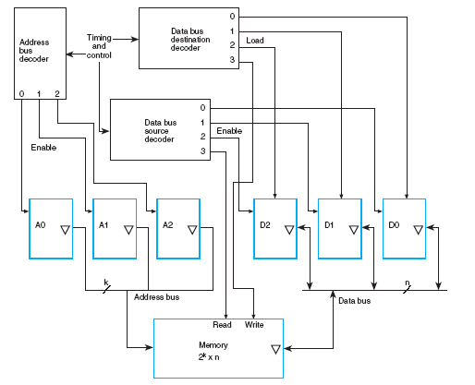
Memory Transfer
One of the
Registers will
be chosen
One of the
Registers will
be chosen to:
Point to an address
in Memory
Read data from
the Memory and Write
into Register D2, D1, D0

Slide 21
Complete Data Path Design

Slide 22
Data Paths --> ALU + Storage
Computer Systems often employ a number of storage elements in conjunction with a shared operation unit called an Arithmetic/Logic Unit (ALU) to form data path.
To perform a micro operation, the contents of a specified source register is applied to the inputs of the shared ALU.
The ALU performs an operation, and the result of this operation is transferred to a destination register.

Slide 23
Data Paths, Single Clock Cycle
Since the ALU is designed as a pure combinational circuit, the entire register transfer operation from the source registers, through the ALU, and into the destination register is performed in one clock cycle.

Slide 24
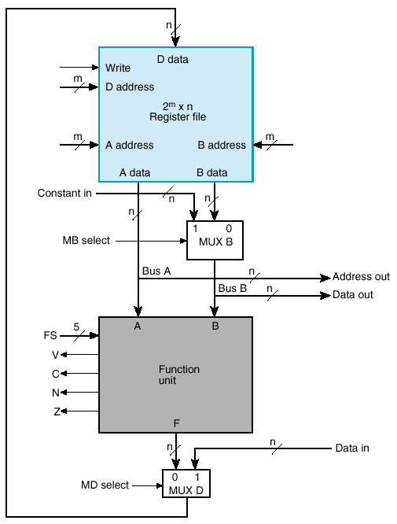
Data Path
(1)Retrieve Data
Operand Fetch
OF
(3)Write Back Results
WB
Memory
(2)Execute Instruction
Store Reg
EX
Memory
Load Register from Memory

Slide 25
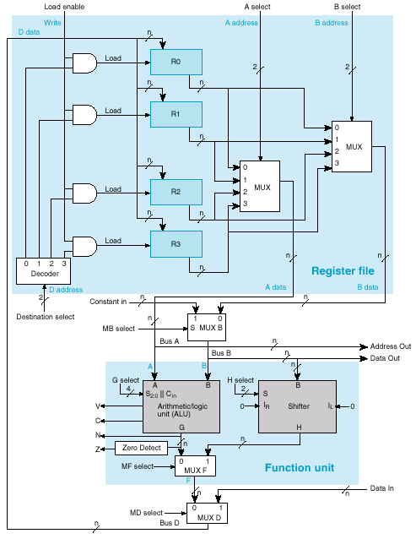
Data Path
A Simple bus-based data path: four registers, an ALU, and a shifter.
Each register is connected to two multiplexers to form ALU input buses A and B (Register File)
Another Mux is used to choose between Registers and a constant.
Functional Unit: ALU and a shifter
Another Mux is used to choose between Functional Unit and external data (Memory)

Slide 26
Data Path
Blue signals are generated by control
Decoder along with the Load-enable signal determines the destination Register (R0,R1,R2,R3)

Slide 27
Data Path
MB Select determines if the source B is a Register or Constant.
G Select determines the operation to be performed by ALU.
MF Select determines if the output is the ALU or Shifter
MD Select determines if the input to the Register File is the Function Unit or external Data.

Slide 28
Data Path
Four status bits are shown (V,C,N,Z) that can be used by the control unit
It is useful to have certain information based on the results of an ALU operation available for use by the control unit to make decisions.???
  Make Corrections
  Skip an instruction
  Loops
  If/Else Statements …

Slide 29
Example: R1←R2+R3
Signals?
  A, B select
  MB Select
  G Select
  MF Select
  MD Select
  Destination (D)
  Load enable
+

Slide 30
Timing of Data Path

Slide 31
Timing
All can occur in one clock cycle, but
  Signals must be available in time to propagate through muxes, ALU and
  Be at Register inputs by next pos-edge

Slide 32
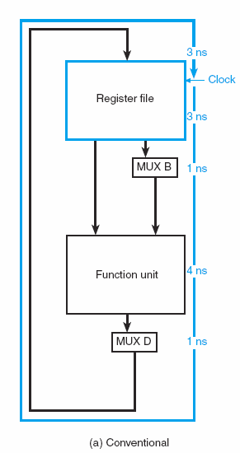
Data Path Timing
The figure shows the maximum delay values for each of the components of a typical data path:
  4ns (3ns + 1ns) to read two operands from register file.
  4ns to perform an operation.
  4ns (1ns + 3ns) to write info back
Total → 12 ns to perform a single micro operation.
The rate of execution is then set at 1/12ns = 83.3MHz
The clock has to be <= 83.3MHZ
Can we make it faster?

Slide 33
Performance Improvement
In addition to providing a data path that performs the necessary register transfer micro operations, we need to be concerned about the speed or rate at which the micro operations are performed. How?
  First we need to know the maximum speed by which our data path can be run.
  Then we will explore how we can make it faster. (Pipelining)

Slide 34
Pipelining

Slide 35
Pipelining
Pipelining exploits parallelism at the instruction level.
  Pipelining is an implementation technique in which multiple instructions are overlapped in execution.
Today pipelining is key to making processors fast.

Slide 36
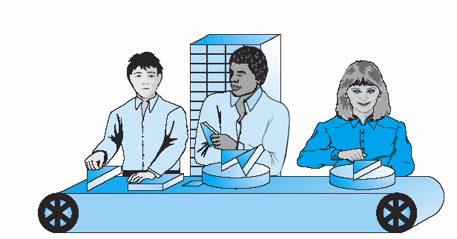
Assembly Line Analogy to
Data Path Pipeline
A product in a factory can be implemented by a single employee
In an Assemply Line instead:
  A custom product being built may pass the assembly line many times before it is completed.
  A conveyor belt moves components from stage to stage
This technique increases throughput
Assemble product on his own
Space
Space
The same product assembled by three

Slide 37
Pipelining: Example
Laundry
Ann, Brian, Cathy, Dave
each have one load of clothes
to wash, dry, and fold
Washer takes 30 minutes
Dryer takes 40 minutes
“Folder” takes 20 minutes
A
B
C
D

Slide 38
Pipelining: Example
Laundry
Ann, Brian, Cathy, Dave
each have one load of clothes
to wash, dry, and fold
  Washer takes 30 minutes
  Dryer takes 40 minutes
  “Folder” takes 20 minutes
Only one student allowed in the laundry room at a time
A
B
C
D

Slide 39
Sequential Laundry
6 PM
7
8
9
10
11
Midnight
Time
30
40
20
30
40
20
30
40
20
30
40
20
T
a
s
k
O
r
d
e
r
A
B
C
D
Sequential laundry takes (90 x 4 = 360 minutes) 6 hours for 4 loads
If they learned pipelining, how long would laundry take?

Slide 40
Pipelining: Example
Laundry
Ann, Brian, Cathy, Dave
each have one load of clothes
to wash, dry, and fold
  Washer takes 30 minutes
  Dryer takes 40 minutes
  “Folder” takes 20 minutes
Modify the Laundry room by partitioning it into 3 independent stages
A
B
A
C
B
A

Slide 41
Pipelining Lessons
6 PM
7
8
9
Tot Time: 210 minutes!! versus 360 with no pipelining
Potential speedup = Number pipe stages
Unbalanced lengths of pipe stages reduces speedup
Time to “fill” pipeline and time to “drain” it reduces speedup
Pipelining doesn’t help latency of single task, it helps throughput of entire workload
Time
T
a
s
k
O
r
d
e
r
30
40
40
40
40
20
A
B
C
D

Slide 42
Conventional Data Path Timing
The figure shows the maximum delay values for each of the components of a typical data path:
  4ns (3ns + 1ns) to read two operands from register file.
  4ns to perform an operation.
  4ns (1ns + 3ns) to write info back
Total → 12 ns to perform a single micro operation.
The rate of execution is then set at 1/12ns = 83.3MHz
Can we make it faster?
OF
EX
OF
/EX
/WB
WB

Slide 43
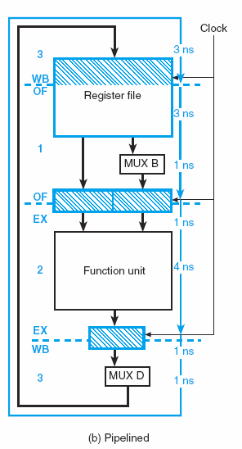
Pipelined Data Path Timing
We can break the delay of 12ns by inserting registers between the different components of the system.
  A register is inserted between the function unit and the register file (OF)
  Another register can be inserted between the function unit and MUX D. (EX + WB)
  3 stage pipeline: OF / EX / WB
The maximum delay now is 5ns allowing a maximum clock frequency of 200 MHz

Slide 44
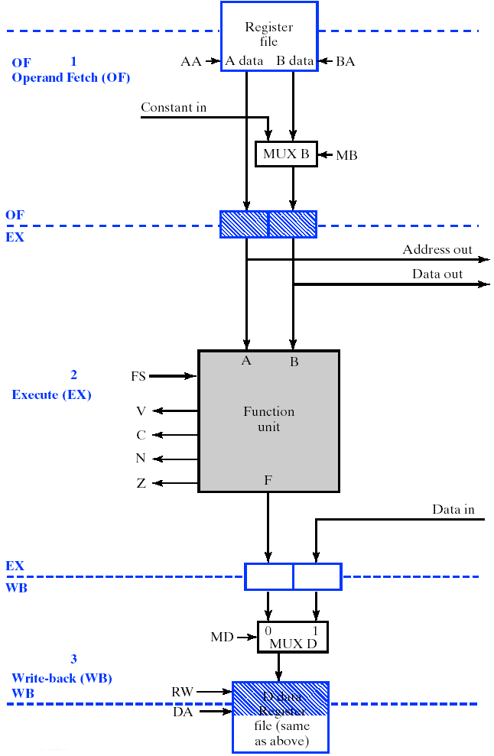
Pipelining
3 Stages
  Operand Fetch
  Execute
  Write Back

Slide 45
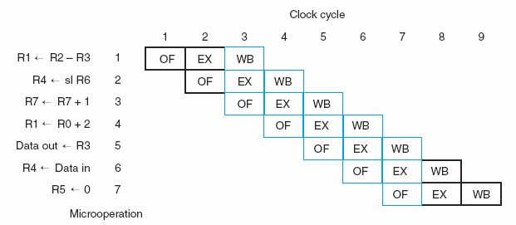
Non-Pipelined Data Path
Conventional data path → 7 x 12ns = 84ns
Each operation takes 12 ns

Slide 46
Pipelining
Conventional data path → 7 x 12ns = 84ns
Pipelined data path:
  → 9 x 5ns = 45ns
Each Clock Cycle now is 5 ns

Slide 47
Summary
Data Paths are an essential part of any CPU.
ALUs (Arithmetic Logic Units) are at the heart of any Data Path.
Multiplexors and Tri-State buffers are used extensively in Data Paths (data movement)
Pipelining is a technique to:
  Improves throughput by overlapping instruction execution.
  Does not improve the latency of each instruction ..

Slide 48
Lecture End

